Slide 1

Unit 02.04.01
CS 5220:
COMPUTER COMMUNICATIONS
Local Area Networks (LANs)
XIAOBO ZHOU, Ph.D.
Professor, Department of Computer Science

Slide 2
What is a LAN?
Private ownership
  freedom from regulatory constraints of WANs
Short distance (~1km) between computers
  low cost
  high-speed, relatively error-free communication
  complex error control unnecessary
Machines are constantly moved
  Keeping track of location of computers a chore
  Simply give each machine a unique address
  Broadcast messages to all machines in the LAN
Need a medium access control protocol

Slide 3
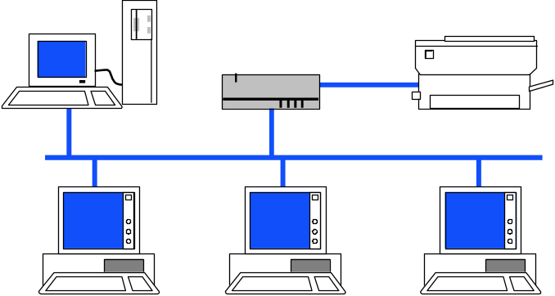
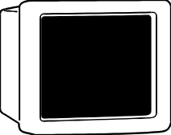
Typical LAN Structure
Transmission Medium
Network Interface Card (NIC)
Unique MAC “physical” address
RAM
Ethernet Processor
NIC
ROM
RAM

Slide 4
Medium Access Control Sublayer
In IEEE 802.1, Data Link Layer divided into:
Medium Access Control Sublayer
  Coordinate access to medium
  Connectionless frame transfer service
  Machines identified by MAC/physical address
  Broadcast frames with MAC addresses
Logical Link Control Sublayer
  Between Network layer & MAC sublayer

Slide 5
MAC Sub-layer
IEEE 802
OSI
Network layer
Network layer
LLC
802.2 Logical link control
Data link
layer
802.3
CSMA-CD
802.5
Token Ring
802.11
Wireless
LAN
Other
LANs
MAC
Various physical layers
Physical
layer
Physical
layer

Slide 6
Logical Link Control Layer
IEEE 802.2: LLC enhances service provided by MAC
A
C
A
Reliable frame service
C
Unreliable Datagram Service
LLC
LLC
LLC
MAC
MAC
MAC
MAC
MAC
MAC
PHY
PHY
PHY
PHY
PHY
PHY

Slide 7
Logical Link Control Services
Type 1: Unacknowledged connectionless service
  Unnumbered frame mode of HDLC
Type 2: Reliable connection-oriented service
  Asynchronous balanced mode of HDLC
Type 3: Acknowledged connectionless service
Additional addressing
  A workstation has a single MAC physical address
  Can handle several logical connections, distinguished by their SAP (service access points).

Slide 8
Encapsulation of MAC frames
IP Packet
IP
LLC PDU
LLC Header
Data
MAC Header
FCS

Slide 9

Ethernet - A bit of history…
1970 ALOHAnet radio network deployed in Hawaiian islands
1973 Metcalf and Boggs invent Ethernet, random access in wired net
1979 DIX Ethernet II Standard
1985 IEEE 802.3 LAN Standard (10 Mbps)
1995 Fast Ethernet (100 Mbps)
1998 Gigabit Ethernet
2002 10 Gigabit Ethernet
Ethernet is dominant LAN standard
Metcalf’s Sketch

Slide 10
IEEE 802.3 MAC: Ethernet
MAC Protocol: CSMA/CD
Slot Time is the critical system parameter
  upper bound on time to detect collision
  upper bound on time to acquire channel
  upper bound on length of frame segment generated by collision
  quantum for retransmission scheduling
  At least round-trip propagation
Truncated binary exponential backoff
  for n_th retransmission: 0 < r < 2^{k}, where k=min(n,10)
  Give up after 16 retransmissions

Slide 11
IEEE 802.3 Original Parameters
Transmission Rate: 10 Mbps
Minimum Frame: 512 bits = 64 bytes
Max Length: 2500 meters + 4 repeaters
Slot time: 51.2 μsec => 512 bits/10 Mbps
Each x10 increase in bit rate, must be accompanied by x10 decrease in distance, or x10 increase in minimum frame size

Slide 12
IEEE 802.3 MAC Frame
802.3 MAC Frame
7
1
6
6
2
4
Preamble
Destination
address
Source
address
Length
Information
Pad
FCS
SD
Synch
Start
frame
64 - 1518 bytes
Every frame transmission begins “from scratch”
Preamble helps receivers synchronize their clocks to transmitter clock
7 bytes of 10101010 generate a square wave
Start frame byte changes to 10101011
Receivers look for change in 10 pattern

Slide 13
IEEE 802.3 MAC Frame
802.3 MAC Frame
7
1
6
6
2
4
Preamble
Destination
address
Source
address
Length
Information
Pad
FCS
SD
Synch
Start
frame
64 - 1518 bytes
0
Single address
Destination address
  single address
  group address
  broadcast = 111...111
Addresses
  local or global
Global addresses
1
Group address
0
Local address
1
Global address

Slide 14
IEEE 802.3 MAC Frame
802.3 MAC Frame
7
1
6
6
2
4
Preamble
Destination
address
Source
address
Length
Information
Pad
FCS
SD
Synch
Start
frame
64 - 1518 bytes
Length: # bytes in information field
  Max frame 1518 bytes, excluding preamble & SD
  Max information 1500 bytes: 05DC
Pad: ensures minimum frame of 64 bytes
FCS: CCITT-32 CRC, covers addresses, length, information, pad fields
  NIC discards frames if failed CRC

Slide 15
Ethernet Scalability
CSMA-CD maximum throughput depends on the normalized delay-bandwidth product a=t_{prop}/X (X is the frame transmission time)
x10 increase in bit rate = x10 decrease in X
To keep a constant need to either: decrease t_{prop} (distance) by x10; or increase frame length x10

Slide 16
Fast Ethernet
Table 6.4 IEEE 802.3 100 Mbps Ethernet medium alternatives
 | 100baseT4 | 100baseT | 100baseFX
Medium | Twisted pair category 3 UTP 4 pairs | Twisted pair category 5 UTP two pairs | Optical fiber multimode Two strands
Max. Segment Length | 100 m | 100 m | 2 km
Topology | Star | Star | Star
To preserve compatibility with 10 Mbps Ethernet:
Same frame format, same interfaces, same protocols
Hub topology only with twisted pair & fiber
Bus topology & coaxial cable abandoned

Slide 17
Gigabit Ethernet
Table 6.3 IEEE 802.3 1 Gbps Fast Ethernet medium alternatives
 | 1000baseSX | 1000baseLX | 1000baseCX | 1000baseT
Medium | Optical fiber multimode Two strands | Optical fiber single mode Two strands | Shielded copper cable | Twisted pair category 5 UTP
Max. Segment Length | 550 m | 5 km | 25 m | 100 m
Topology | Star | Star | Star | Star
Slot time increased to 512 bytes; small frames need to be extended to 512 Bytes
Frame bursting to allow stations to transmit burst of short frames
Frame structure preserved but CSMA-CD essentially abandoned, and operated primarily in a switched mode
Extensive deployment in backbone of enterprise data networks and server farms

Slide 18
10 Gigabit Ethernet
Table 6.5 IEEE 802.3 10 Gbps Ethernet medium alternatives
 | 10GbaseSR | 10GBaseLR | 10GbaseEW | 10GbaseLX4
Medium | Two optical fibers Multimode at 850 nm 64B66B code | Two optical fibers Single-mode at 1310 nm 64B66B | Two optical fibers Single-mode at 1550 nm SONET compatibility | Two optical fibers multimode/single-mode with four wavelengths at 1310 nm band 8B10B code
Max. Segment Length | 300 m | 10 km | 40 km | 300 m – 10 km
Frame structure preserved
CSMA-CD protocol officially abandoned
LAN PHY for local network applications
WAN PHY for wide area interconnection using SONET OC-192c
Extensive deployment in metro networks and in datacenters

